Slide 1
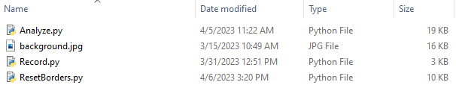
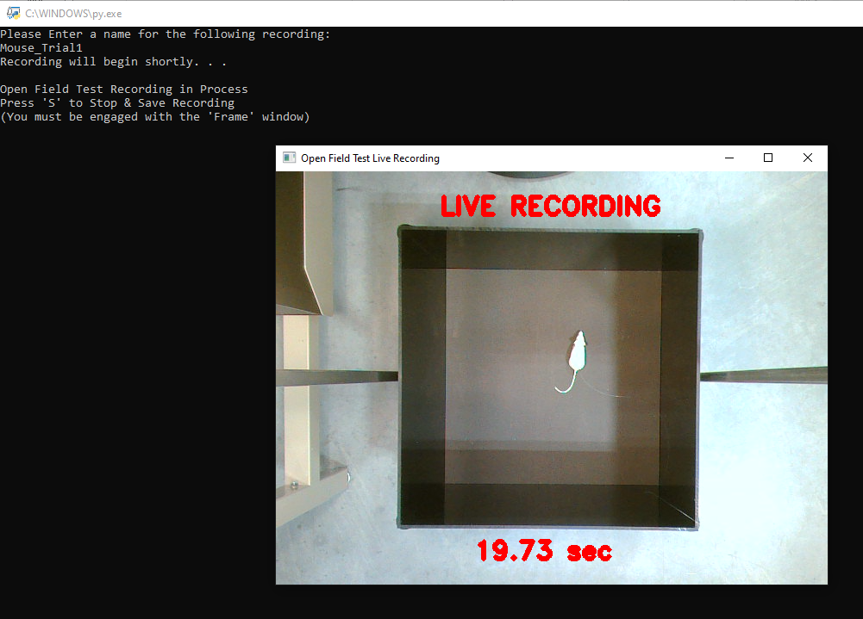
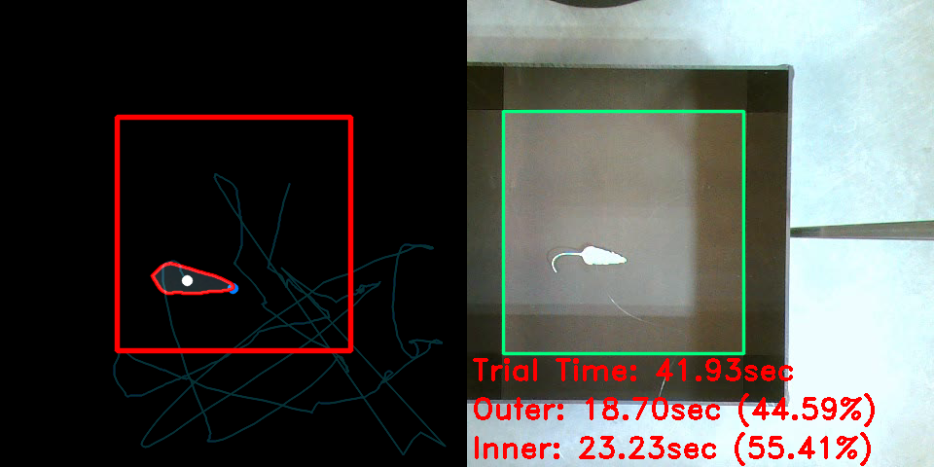
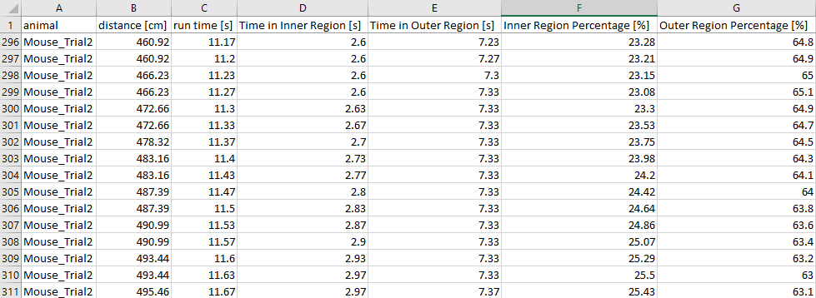
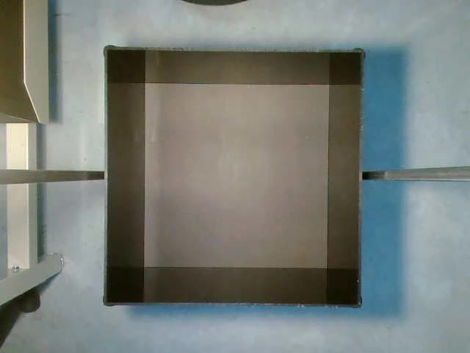
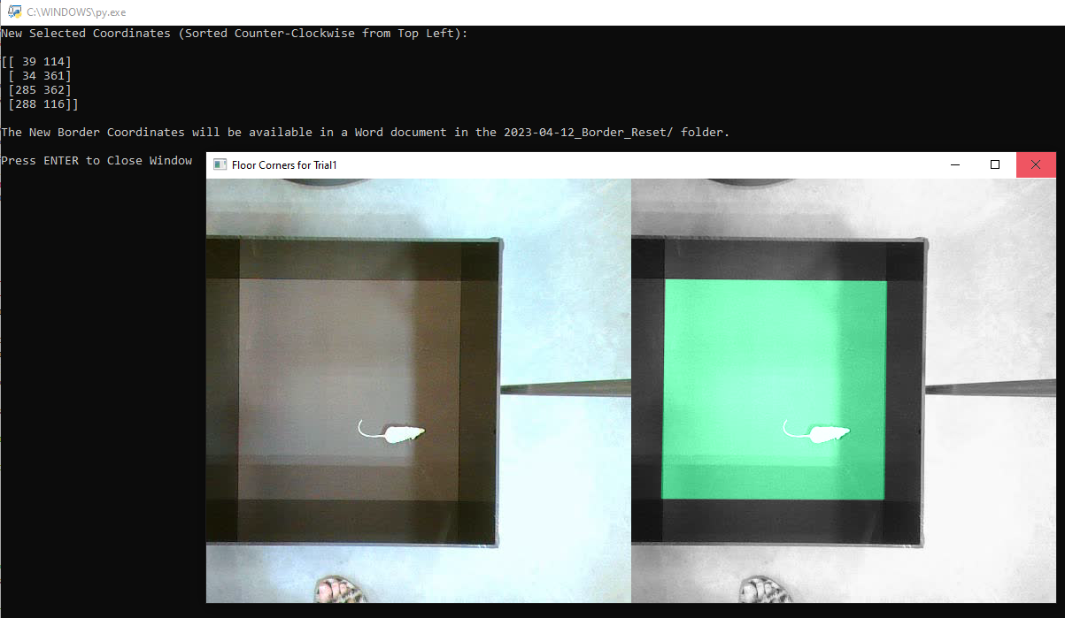
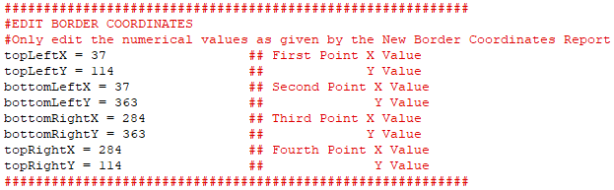
Visual Tracking System for Animal Behavioral Assays User Manual
Basic Program Overview
Basic VTS Setup
This Visual Tracking System (VTS) is comprised of two basic Python Scripts that can be ran succession to effectively record (Record.py) and analyze (Analyze.py) the mouse in the Open Field test (OFT) and output data into a .csv file, as well as a preset background.jpg that allows the code to compare the video against an empty OFT. There is also a ResetBorder.py that is for the convenience of helping to reset OFT boundaries.
Python and OpenCV must be downloaded on the main operating computer. Use these tutorials to install Python and OpenCV. Make sure that the Webcam is plugged into the computer and set as the primary camera device. Turn the light on. Make sure that it is out of view of the camera and leaving a consistent gradient of light over the floor of the OFT. Put all four files (Record.py, Analyze.py, background.jpg, and optional ResetBorders.py) into any folder.
Record.py
Make sure that the Record.py script is in whatever folder you want the videos to be saved into. Then, click the script to run it and begin recording, if the webcam is connected properly. Follow the onscreen instructions to insert a filename for the video recording, and then to properly close the window. The screen will signify the video saving successfully and will save the video as an .avi file into the same folder. After following the first prompt, the screen should look like the image to the right.
Analyze.py
This is the second step in the VST Python script process. Simply, click the file to run. It will open a screen for every .avi file that exists in the same folder and the user will have to, following the onscreen instructions, click within the video capture display screen and then press enter to continue. A screen similar to the image on the right will appear and change as the video is analyzed. After all of the video/s are processed, there will be a new folder that appears titled [date]_trial. This folder will contain another folder containing the traces (screenshot of the analysis portion), the .csv file with region location timing and data for the trial (example data output shown on lower right), as well as, an error report that will tell how many of the frames and seconds have been compromised by the inability of the code to recognize contours.
background.png
The background.png will be preloaded into the directory. The purpose of this image is for the Analyze.py script to have a basis to compare an empty OFT to one with a mouse in it and then more easily detect contours. If this file needs to be updated for any reason such as a change in lighting or movement of the camera local, it is important that this file has the same resolution and dimensions as the webcam will be recording, and even lighting across the floor.
ResetBorders.py
The boundaries for the OFT in the Analyze.py code have been preset assuming they will be unmoved, but this file offers a way to manually change the border. When opened, this script will pull up the first frame from whatever .avi files are in the folder, so record the altered OFT boundaries first. Then, the user will be able to click through the four edges of the box to set new boundaries. The new coordinates that the user has chosen will appear on the black screen and be output to a new Word doc in a new [date}_Border_Reset folder. NOTE: It is recommended to do multiple trials to accurately determine which new coordinates are needed, before changing the pre-existing ones. Once, the user is satisfied with a consistent set of points or averaged to get the most accurate, the user can open up the Analyze.py script to EDIT. Then, edit the values to be consistent with the coordinates from the Word doc.
FAQ & Troubleshooting
What do I do if the Analyze.py script will not run?
Make sure that any pre-existing .csv files or any error reports and traces of any analyzed .avi files in the folder are closed. Make sure that you have not altered any text with the Analyze.py while changing borders (other than that you should not be editing this file). If you have changed it, get a new copy of Analyze.py file.
Make sure there is an .avi file in the folder, to be analyzed. Python needs to be installed on the computer.
What do I do if the WebCam can’t be accessed?
Open Device Manger and make sure that the WebCam is your preferred camera. You may need to disable the default camera under Cameras or Imaging Devices.
Why am I getting frames that don’t work in the Error Report?
This likely means that the contour function used in the code isn’t working right. Make sure that the lighting is evenly covering the OFT and that the background.jpg is as close as possible to the current lighting characteristics.
The basis for the Analyze,py code was developed utilizing source code from: https://github.com/colinlaney/animal-tracking

